Slide 1
A Primer on Using OpenDSS for Verifying Your Power System Simulations
Aryan Ritwajeet Jha
Notes:
Remember to hit the reset button to make sure all the page elements react properly.
There are 20 different layouts that you can choose from.

Slide 2
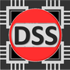
OpenDSS Introduction
OpenDSS is an Electric Power Distribution System Simulator (DSS).
It is Free, Open-source. It was originally designed by EPRI, and is now maintained/updated by it and the wider Power Systems community.
OpenDSS can perform:
Unbalanced, Multi-phase Powerflow
Quasi-Static Time-Series (QSTS) Simulations
Fault Analysis
Other capabilities include Harmonic Analysis, Flicker Analysis, Linear and Nonlinear Analysis, Stray Voltage/Current Analysis (not talked about in this presentation)

Slide 3


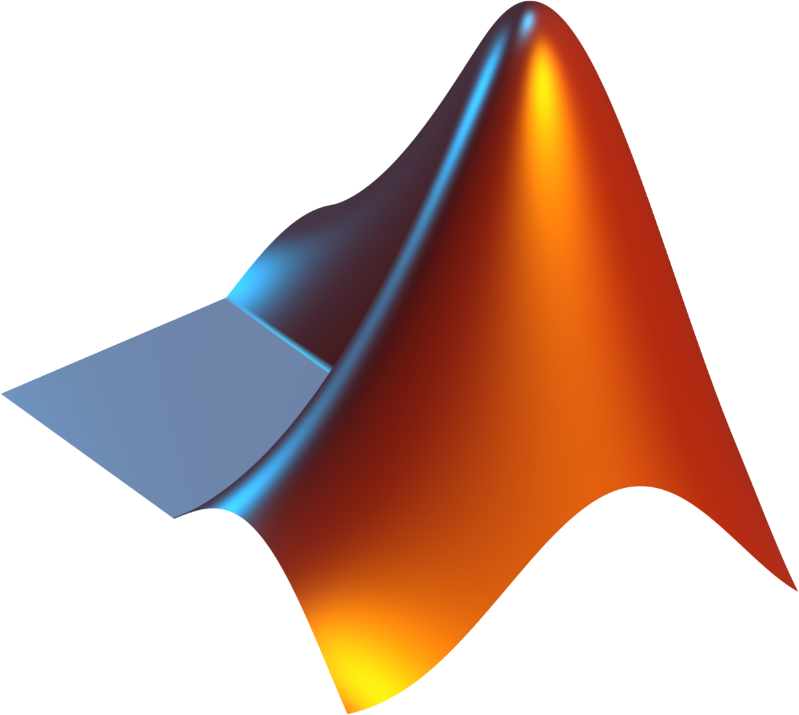

OpenDSS Introduction
It does NOT do:
Optimal Power Flow (it is not an optimization solver)
Basically, OpenDSS is an excellent compiler, parser and Powerflow solver, but is not an equivalent of a programming language.
Often, in order to do even slightly non-trivial tasks (which otherwise would require the user to do a lot of manual work), OpenDSS requires you to interface with it via a regular programming language).
Some languages are officially supported, but in theory any language can be used to script the creation of OpenDSS files, which subsequently may be run using the OpenDSS GUI.

Slide 4
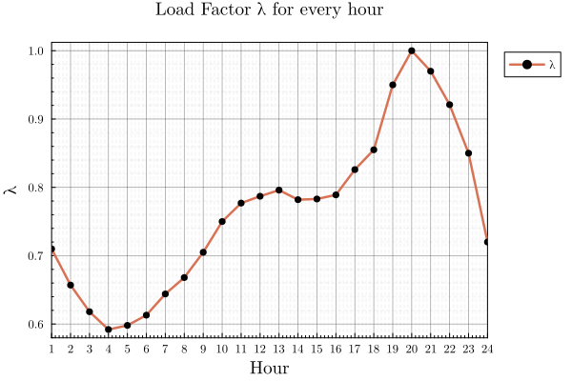
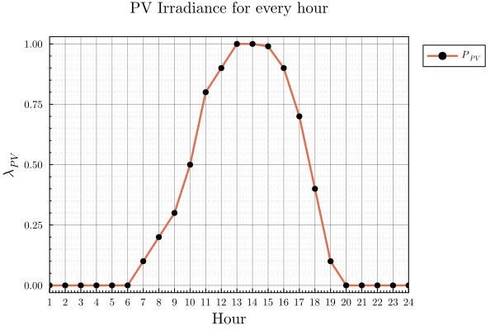
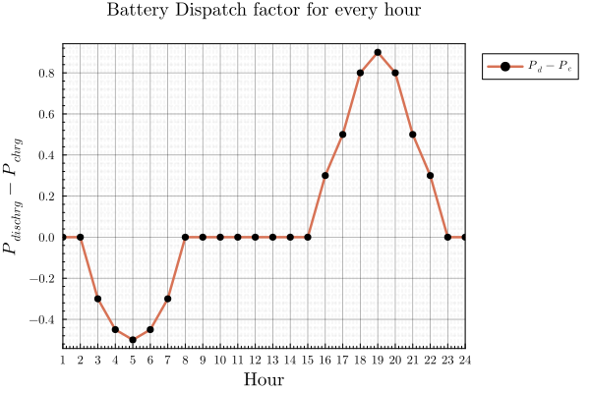
OpenDSS Introduction
OpenDSS offers very high modelling flexibility. You can have a system with
1-phase and/or 2-phase and/or 3-phase (really, any n-phase) components
Transformers, Relays, Reactors, Capacitors
Generators, PVs, Storage, Inverters
Control Elements to control PVs, Storage, etc.
Custom profiles for each element, say load variation, PV real-power variation, Battery Charging/Discharging cycles
And it will just solve for the powerflows! (And allows for exporting of key variables/time-series)

Slide 5
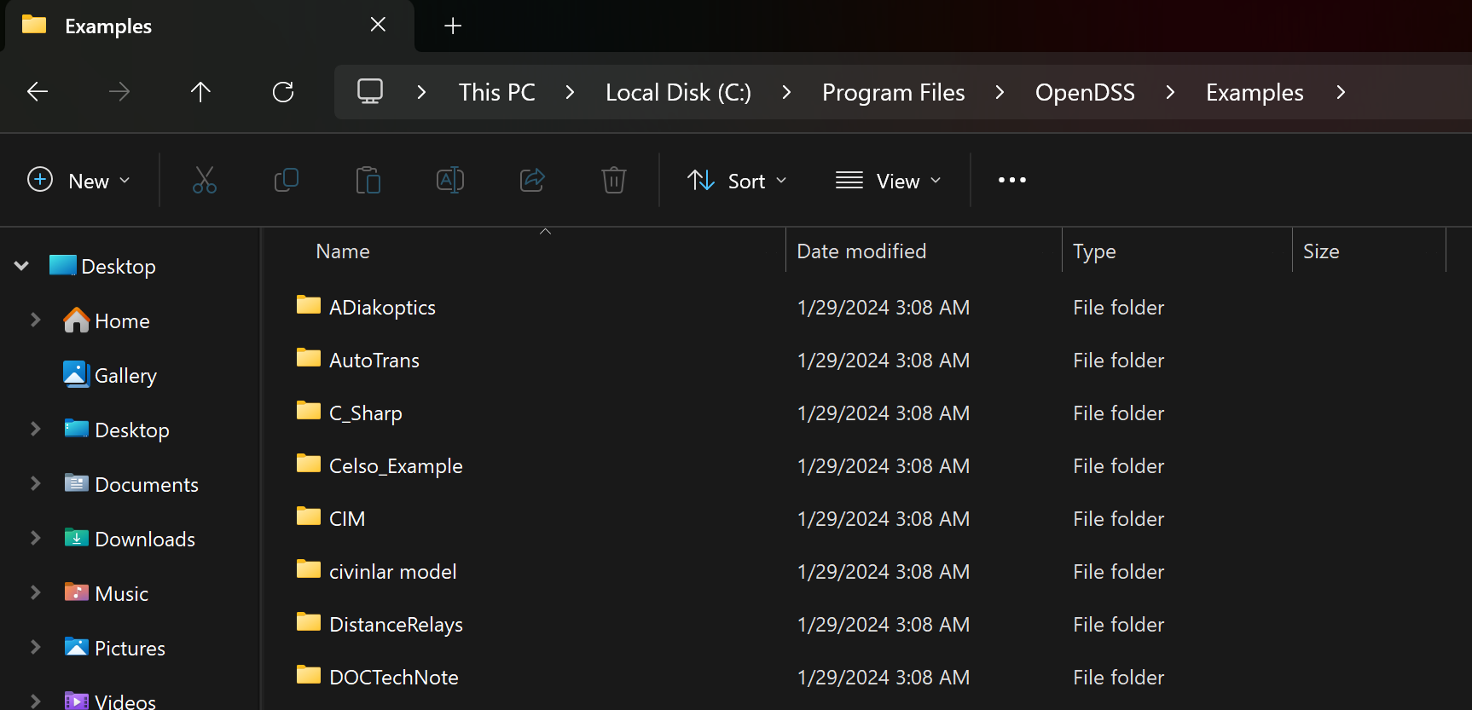
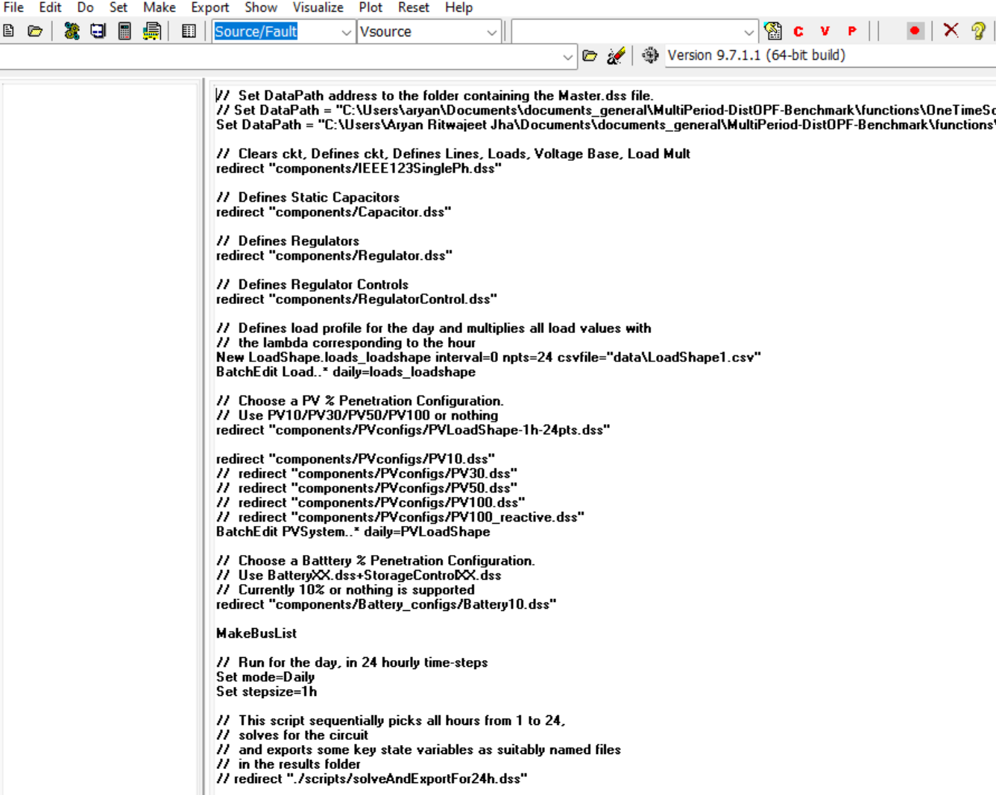
How can I easily see OpenDSS’s capabilities myself?
Simple. Download OpenDSS.
Go to the Examples folder in its directory
Open any file of your interest in OpenDSS
Ctrl+A, Ctrl+D to ‘Solve’ for the system (you’ll get the solution on the left)

Slide 6
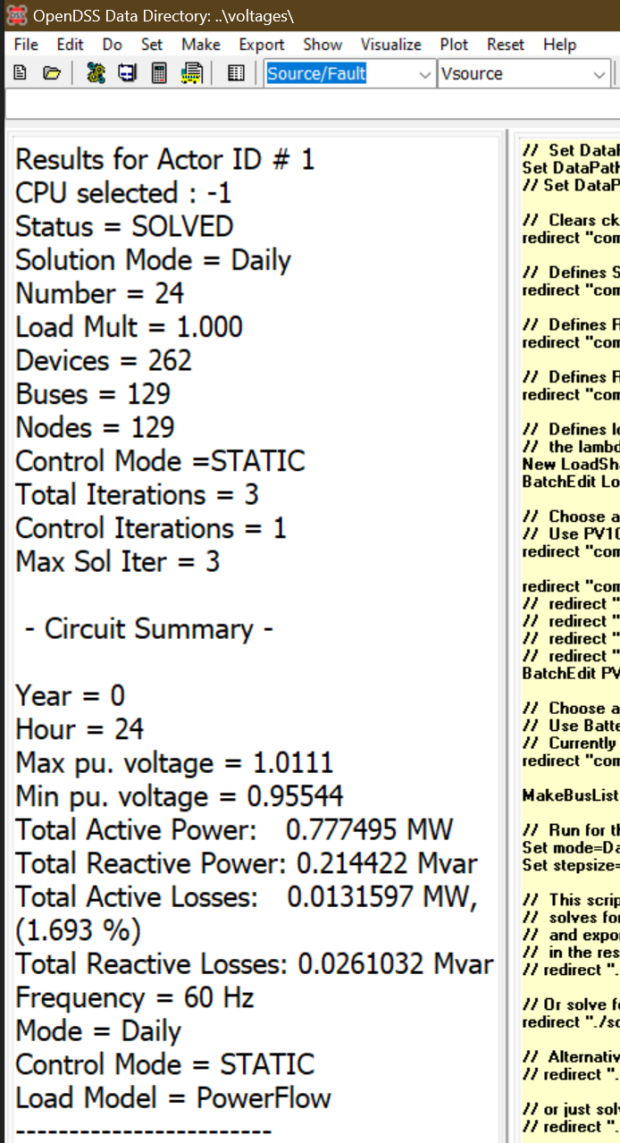
How can I easily see OpenDSS’s capabilities myself?
Ctrl+A, Ctrl+D to ‘Solve’ for the system (you’ll get the solution on the left side: here, the orange-coloured area)
Ctrl+A, Ctrl+D

Slide 7
How can I model my own system?
OpenDSS isn’t a full-fledged programming language (e.g., it does not have a for loop or an if condition or a capability of string manipulation)
Install the COM/OpenDSSDirect interface for your language
OpenDSSDirect.py (installs DSS-Python)
PyDSS (utilizes OpenDSSDirect.py; has some T&D co-simulation capabilities such as a built-in HELICS Interface [About])
More details at the end of the presentation.
OpenDSSDirect.jl
DSS_MATLAB

Slide 8
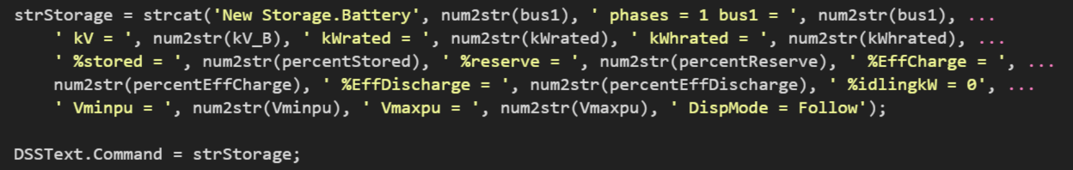
How can I model my own system?
Define all your components via OpenDSS commands (Basically you make strings containing the lines of codes interpretable by OpenDSS)
You write this: (here, an instantiation of storage at a bus, typically inside a for loop for multiple elements)
So that OpenDSS can interpret it as given below (OpenDSS now knows that a Storage unit named ‘Battery9’ is at bus 9).

Slide 9
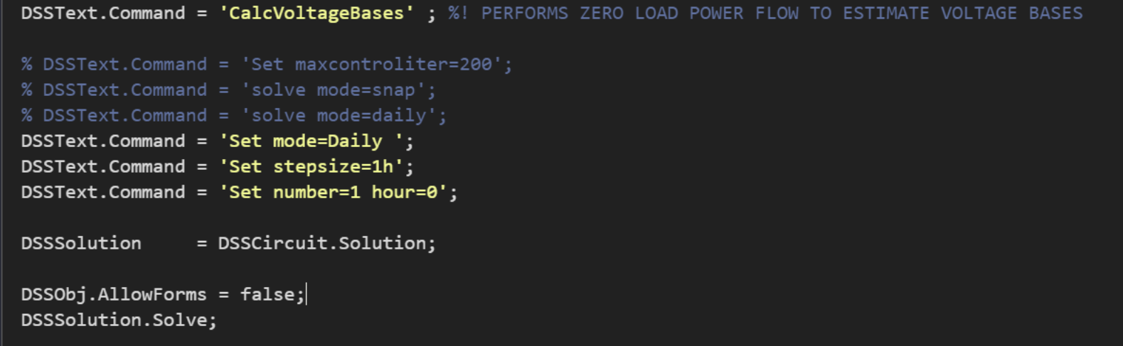
How to run Powerflow for my system and export relevant data?
Just run a ‘solve’ command on the circuit you’ve defined.

Slide 10
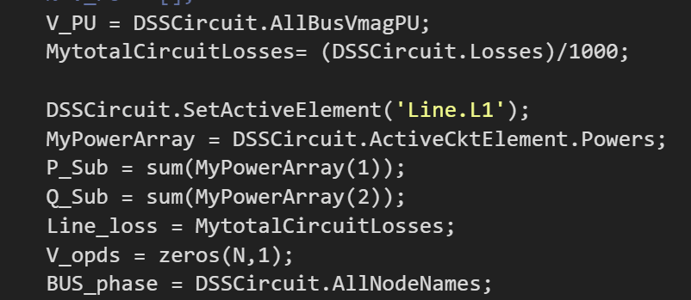
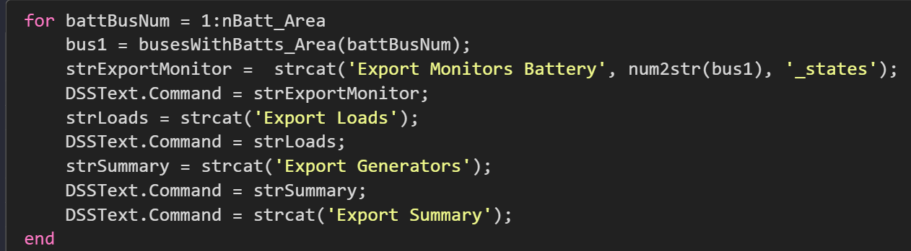
How to run Powerflow for my system and export relevant data?
Once the solution is obtained, you can check out any results for any components you’d like, generate CSV files for them, and plot them.
If you’re interested in time-series for a specific component, you may place a ‘Monitor’ on it. After a QSTS Simulation, the monitor will store the values at every time-step.
Extracting Voltages, Losses, Substation Powers after a Powerflow run
Exporting Monitors for Loads, PVs, Batteries which have state variable values for the corresponding component.

Slide 11
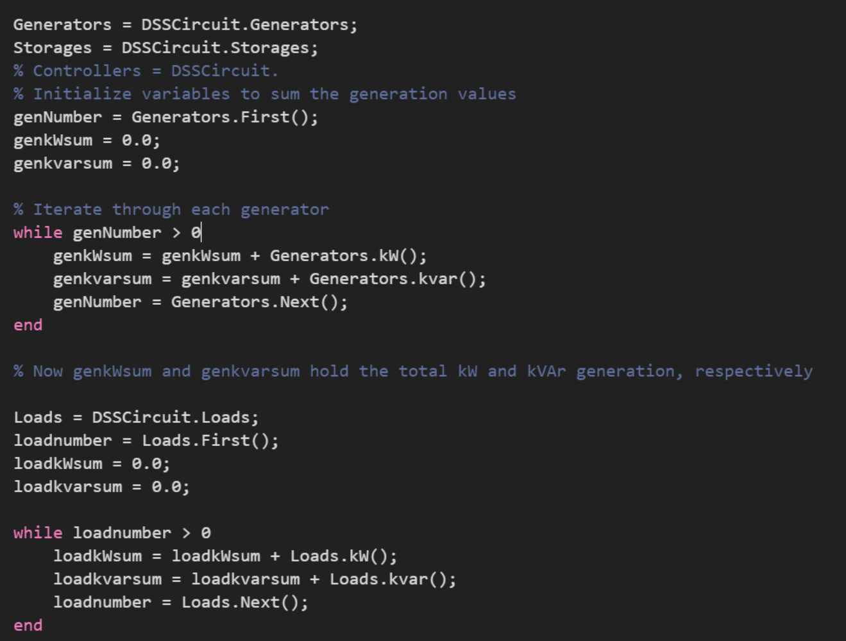
How to run Powerflow for my system and export relevant data?
Certain variables, which don’t fall under a blanket API command can be extracted using for loops.
Here is a repo where the COM interface is utilized with MATLAB to define and run a system.
Here, I’m computing the total system load and PV Generation

Slide 12
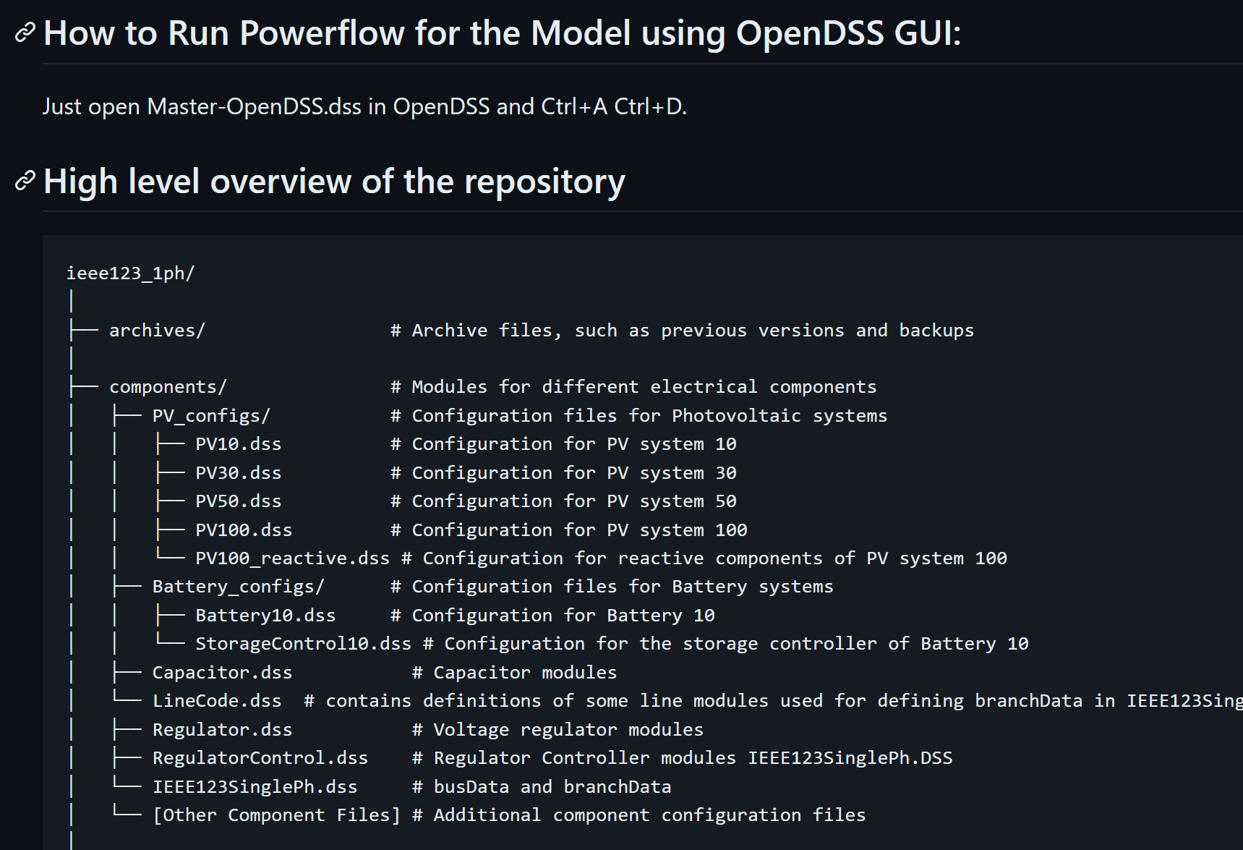
Running the Model using OpenDSS GUI
In theory, you can make all the scripts before-hand, and export them all as .DSS files so that someone who can only run OpenDSS GUI (not to be confused with OpenDSS-G) can still run them.
This repo is an example.

Slide 13
Cons
Comes with some tribal knowledge. It has some idiosyncrasies which can at times appear unintuitive (for me some stuff still is)
Sourceforge forum is the only forum where questions are answered
Dead links every now and then in the forum
This is not so bad in comparison (Forum for PSSE)
Many seemingly routine procedures may not have an easy-to-use API. So you kind of have to create your home-made script (or apply some manual labour) in such cases.

Slide 14
Final note
OpenDSS is a very powerful tool to verify your Power System simulation.
Verification against OpenDSS is appreciated by the research community (considered good enough for Distribution Systems, no need of any Proprietary Simulation Software for QSTS Simulations).
Sensible, concise documentation
Good Community on the forum, with EPRI’s staff chipping in to help you from time to time.
Modelling your whole system and verifying it is just a couple of for loops away!

Slide 15
Resources to Learn OpenDSS
EPRI’s Documentation on OpenDSS
EPRI’s Original Tutorial Playlist on OpenDSS
EPRI’s Paulo Radatz’s Playlist on OpenDSS
Dr. David Lubkeman’s Lectures as part of Power Distribution Systems course at North Carolina State University.
[Python Users] OpenDSSDirect.py landing page will guide you through installation, tutorial examples and documentation.
Feel free to message me if you have any doubts

Slide 16
Post-presentation notes on OpenDSS Suggestions, Pitfalls, etc.
LineCodes take precedence over lines defined by you (for example if units in LineCodes are in miles, then a user defined specification of units in km will be ignored)
If you accidentally 're-specify' certain parameters, say `phases = 1 phases 3` in the same line for a load, OpenDSS does not throw an error, but simply takes the last specified value.
When working with Split-phase transformers, information related to per-phase loads can be lost (so not everything can be easily retrieved from an OpenDSS simulation, as I claimed earlier).

Slide 17
Post-presentation notes on OpenDSS Suggestions, Pitfalls, etc.
Try to implement a smaller test system (from your research or a system you're familiar with, such as the 14 bus system from EE 521) into OpenDSS (via a COM interface in the language of your choice) to understand the nuances of using OpenDSS .

Slide 18
Additional Clarifications on Different Packages for Usage with OpenDSS follow…
With a focus on the Python packages.

Slide 19
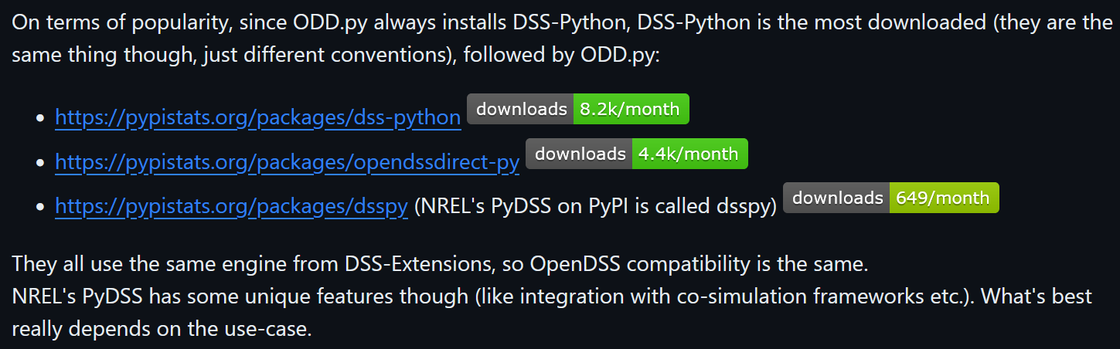
Paulo Meira’s [2, 3] explanation disambiguating the existing Python Packages interfacing with OpenDSS

Slide 20
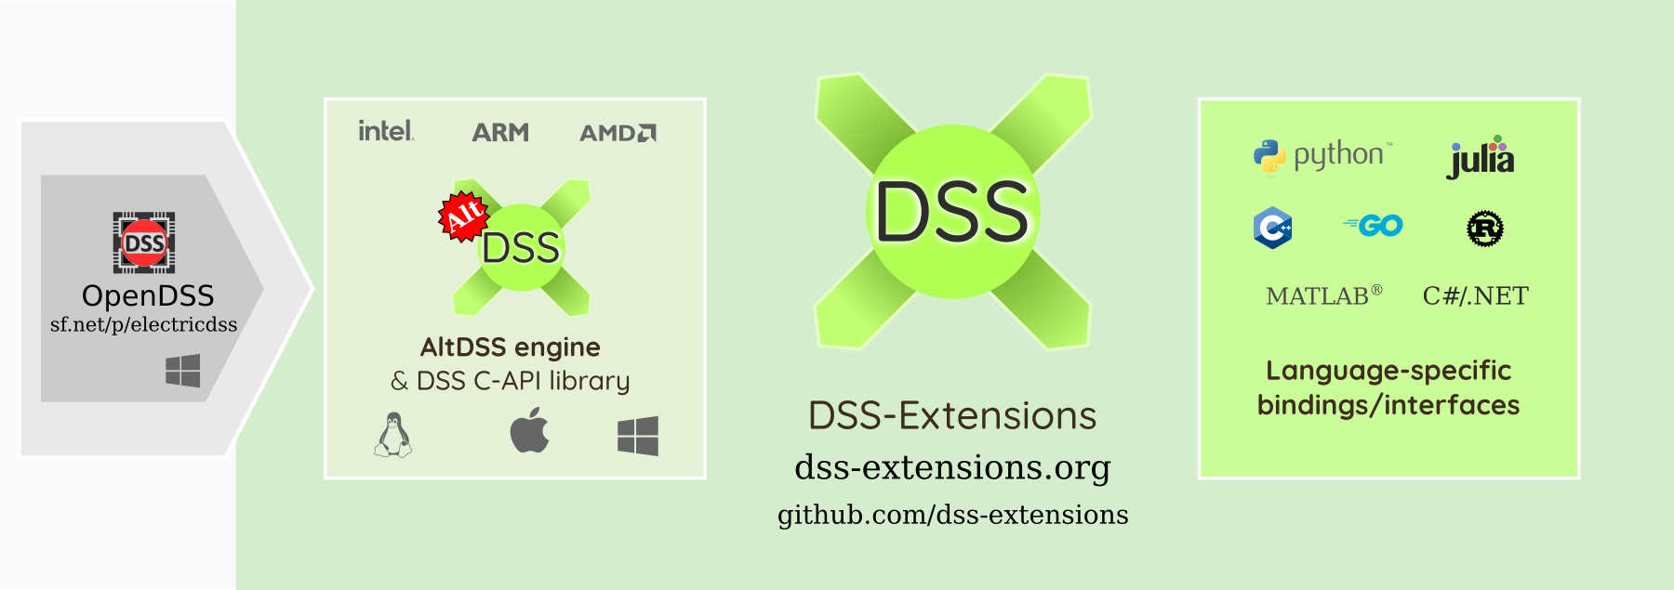
Many of these packages are wrapper packages which invoke the AltDSS Library. It is typical for the same teams/people to be working on multiple packages. It is also typical for a package to be utilizing some/all features of another.
Aside/Clarification
A
B
Package A invokes Package B
OpenDSSDirect.py (installs DSS-Python)
PyDSS (utilizes OpenDSSDirect.py; has some T&D co-simulation capabilities such as a built-in HELICS Interface [About])
OpenDSSDirect.jl
DSS_MATLAB

Slide 21
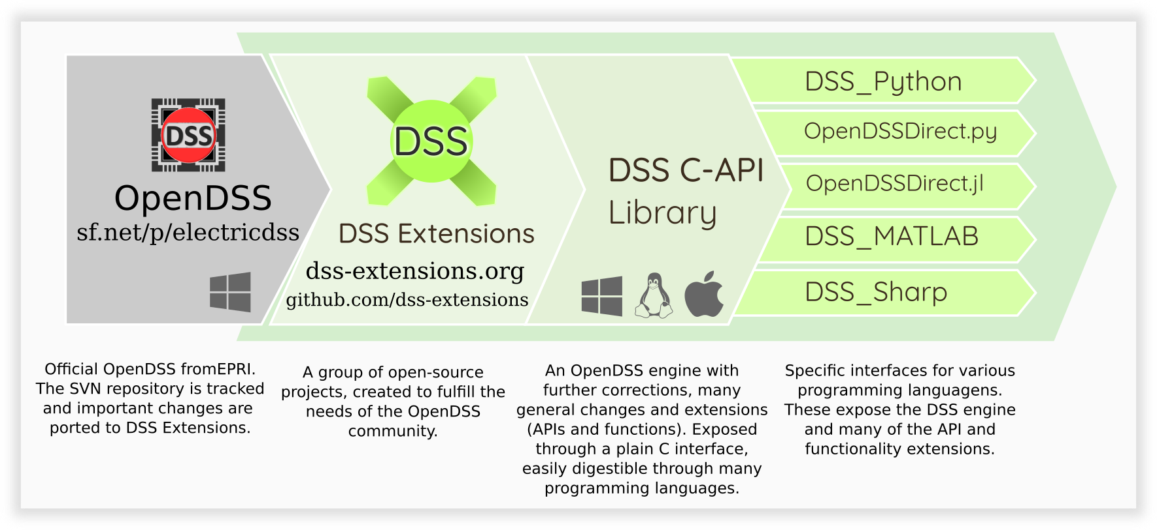
More information may be accessed on the dss-extensions website
Aside/Clarification

Slide 22
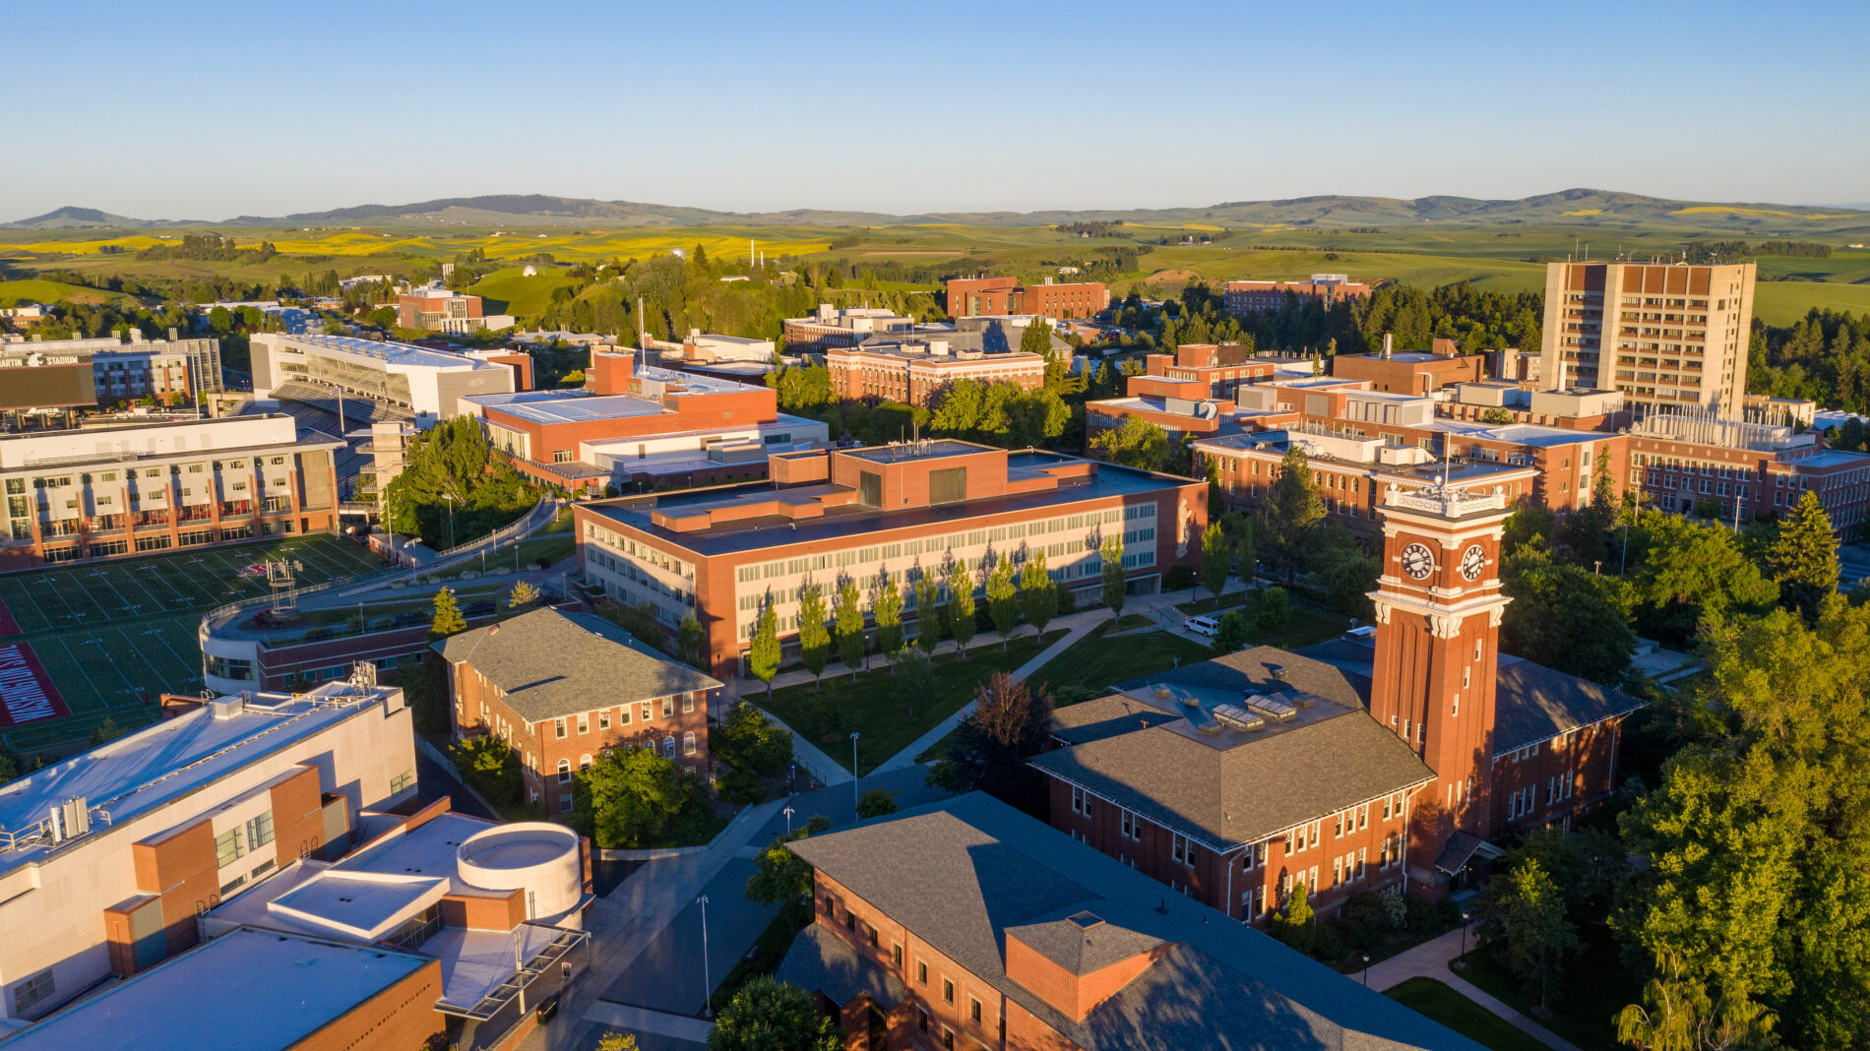
Thank You.

Slide 23
Acknowledgements
Paulo Meira [2, 3] for fact-checking certain statements and taking the time to explain to me the intricacies behind the overall ecosystem of packages interfacing with OpenDSS.
Lab mates Abodh, Daniel and Surendra for their inputs.

